Slide 1

A Bakery in New York
K. Lucas

Slide 2
“Make your mark in New York and you are a made man.”
- Mark Twain

Slide 3
Agenda
The Problem
The Data
The Methodology
Results
Recommendations
Conclusion

Slide 4
The Problem
We needed to identify a location in New York City that is amenable to the opening of a bagel/coffee/dessert shop.
This location needed to have limited competition and demonstrate potential for a growing population (demand base).

Slide 5
The Data
Data came from three sources:
Foursquare Application – this application provided venue information, including type of venue and location.
“The New York City Population Projections by Age/Sex & Borough, 2010-2040” – this report provided past, current, and future population levels and growth percentages.
New York City JSON – this provided Borough and Neighborhood locations. This data, coupled with the Foursquare Application, allows the locating of venues within their Borough and Neighborhood.

Slide 6
The Methodology
The analysis of the data proceeded over the following steps:
Analyzing the distribution of venues across New York City.
Cluster the neighborhoods by venue types.
Identify the neighborhoods with a high density of coffee/bagel/bakery shops. Focus on the low-density neighborhoods.
Cross-reference the low-density neighborhoods with expected population growth. Identify the low-density neighborhoods with an expectation for population growth.

Slide 7
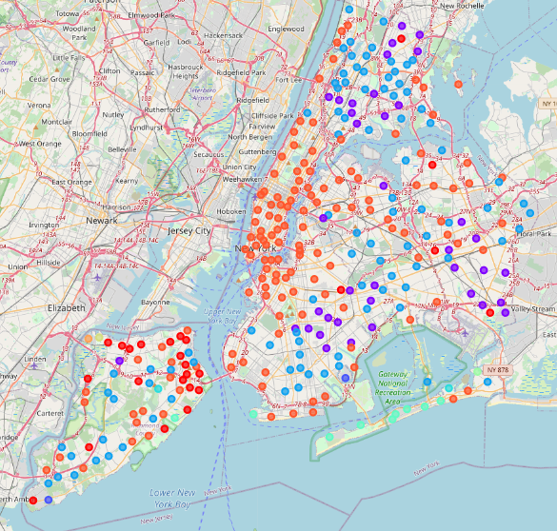
Results – Neighborhood Clusters
Cluster | Color | Number of Venues | Venue Types
1 | Red | 25 | Deli/Bodega and Markets
2 | Purple | 38 | Bus Stations and Donut Shops
3 | Blue | 2 | Pools and Fitness Venues
4 | Aqua | 93 | Donut, Coffee, and Pizza
5 | Turquoise | 2 | Parks and Exhibits
6 | Green | 9 | Beach, Bodegas
7 | Yellow | 1 | Playground and Yoga
8 | Lemon | 1 | Casual Dining
9 | Apricot | 1 | Ferry and Casual Dining
10 | Orange | 134 | Casual Dining

Slide 8
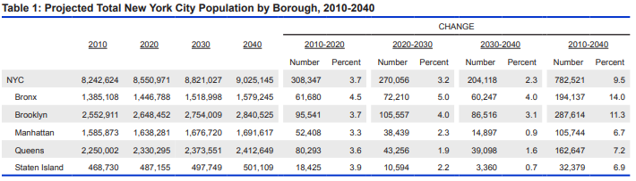
Results – Population Growth
Highest Growth Potential
Bronx
Brooklyn

Slide 9
Results – Cluster Analysis
Borough | Neighbourhood | 1st Most Common Venue | 2nd Most Common Venue | 3rd Most Common Venue | 4th Most Common Venue | 5th Most Common Venue | 6th Most Common Venue | 7th Most Common Venue | 8th Most Common Venue | 9th Most Common Venue | 10th Most Common Venue
Bronx | Edenwald | Grocery Store | Deli / Bodega | Supermarket | Chinese Restaurant | Playground | Yoga Studio | Farm | Farmers Market | Fast Food Restaurant | Field
Brooklyn | Ocean Hill | Deli / Bodega | Bus Stop | Grocery Store | Supermarket | Southern / Soul Food Restaurant | Fried Chicken Joint | Dry Cleaner | Hardware Store | Chinese Restaurant | Coffee Shop
Queens | Whitestone | Dance Studio | Deli / Bodega | Bubble Tea Shop | Candy Store | Food & Drink Shop | Farm | Farmers Market | Fast Food Restaurant | Field | Filipino Restaurant
Queens | Briarwood | Deli / Bodega | Gym | Bus Station | Coffee Shop | Convenience Store | Home Service | Indian Restaurant | Playground | Factory | Falafel Restaurant
Queens | Brookville | Recording Studio | Deli / Bodega | Yoga Studio | Flower Shop | Factory | Falafel Restaurant | Farm | Farmers Market | Fast Food Restaurant | Field
Staten Island | New Brighton | Bus Stop | Deli / Bodega | Park | Playground | Discount Store | Bowling Alley | Farm | Farmers Market | Fast Food Restaurant | Field
…
Staten Island | Fox Hills | Grocery Store | African Restaurant | Bus Stop | Playground | Sandwich Place | Flea Market | Factory | Falafel Restaurant | Farm | Farmers
- Cluster 1 had the lowest number of venues similar to coffee/bagel/dessert shops.
- Queens and Staten Island locations eliminated due to lower population growth.

Slide 10
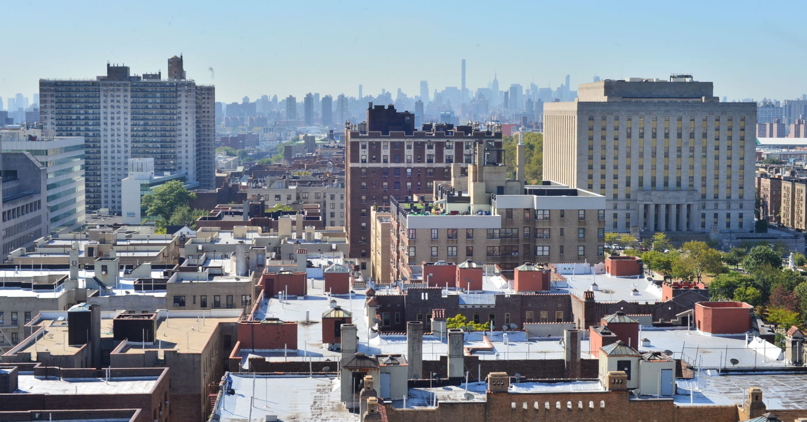
Recommendations
Construction of Bagel/Coffee shop in one of the two neighborhoods:
- Edenwald, Bronx
- Ocean Hill, Brooklyn
Image from: KseniyaPhoto

Slide 11
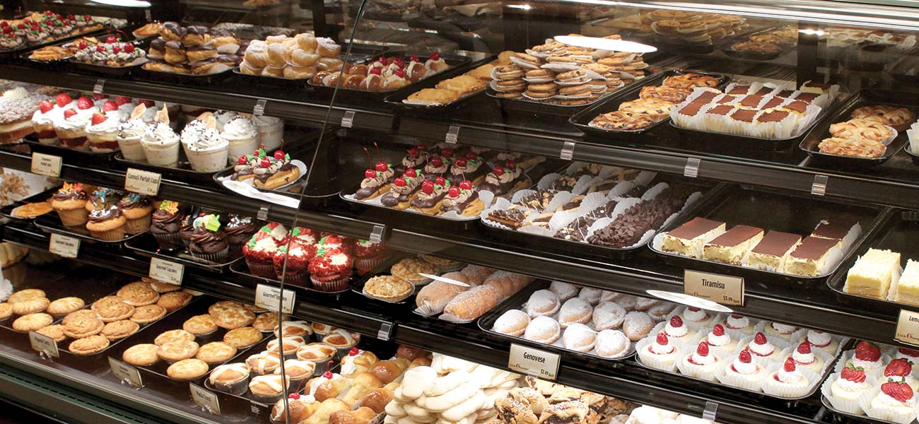
Conclusion
New York City provides has great opportunities for new businesses.
The coffee/bakery industry has deep roots and density in New York City.
The two identified neighborhoods provide a low-density location with templated population growth.
Image from: https://uncleg.com/departments/bakery/

